Slide 1
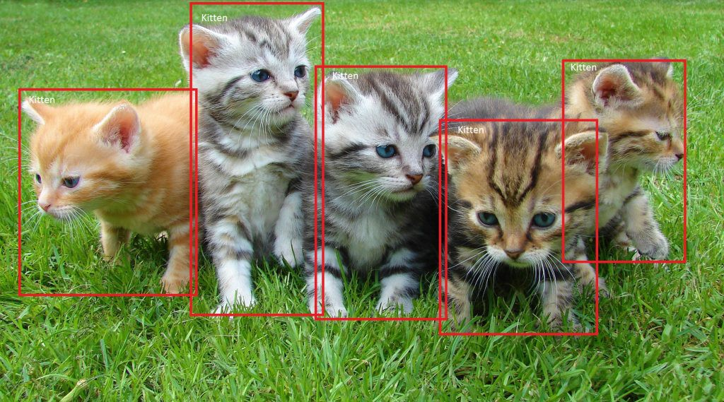
SSD: Single Shot MultiBox Detector 29 Dec 2016 UNC Chapel Hill, Zoox Inc., Google Inc. and University of Michigan, Ann-Arbor
Daniel Kovachev & Yuval Amrami
Example of end-to-end object detection in a Box (from Microsoft)

Slide 2
Problem Definition
Given an image as input
Predict bounding boxes and class labels for each object in the image.
Object Detection

Slide 3
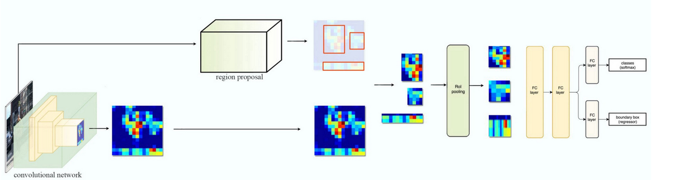
Fast R-CNN

Slide 4
Fast R-CNN Problems
Training phase is too long
Training happens in multiple phases (e.g. training region proposal vs classifier)
Network is too slow at inference time(2 seconds)

Slide 5
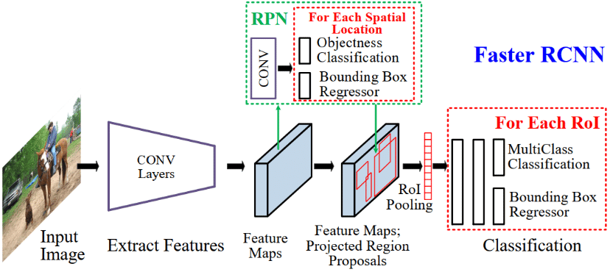
Faster R-CNN

Slide 6
Faster R-CNN Problems
Training phase is too long
Network is too slow at inference time (0.2 seconds)

Slide 7
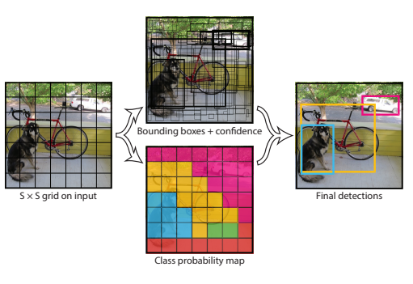
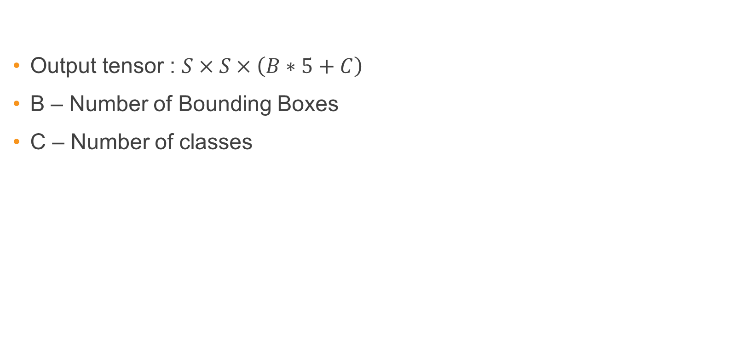
YOLO – You Only Look Once
Output tensor : $S×S×\left(B∗5+C\right)$
B – Number of Bounding Boxes
C – Number of classes

Slide 8
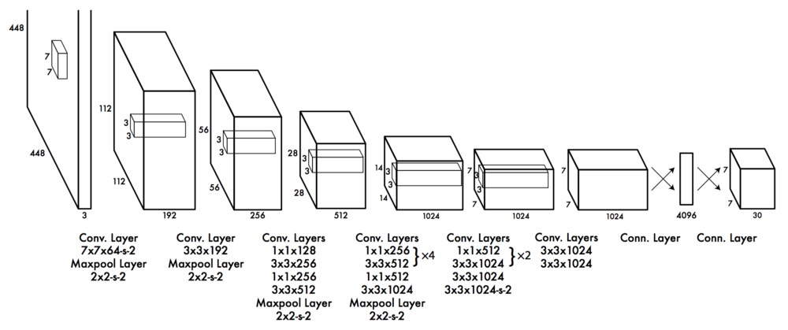
YOLO – You Only Look Once

Slide 9
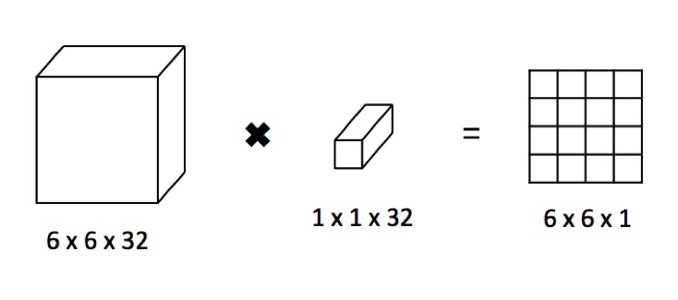
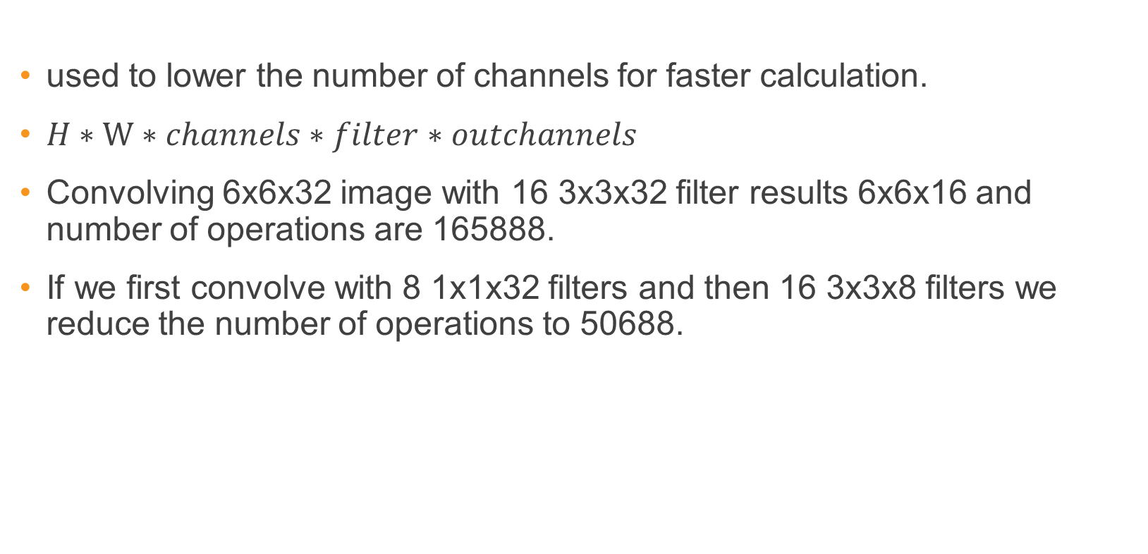
1x1 conv layer
used to lower the number of channels for faster calculation.
$H∗W∗channels∗filter∗outchannels$
Convolving 6x6x32 image with 16 3x3x32 filter results 6x6x16 and number of operations are 165888.
If we first convolve with 8 1x1x32 filters and then 16 3x3x8 filters we reduce the number of operations to 50688.

Slide 10
YOLO Problems
Low Accuracy compared to Faster R-CNN.
Struggle with small objects.

Slide 11
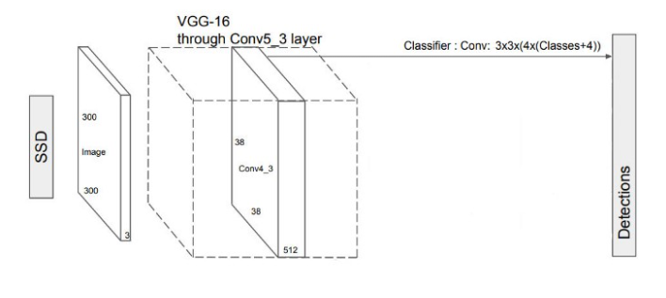
Single Shot MultiBox Detector
extract features
predict class probabilities & bounding boxes location

Slide 12
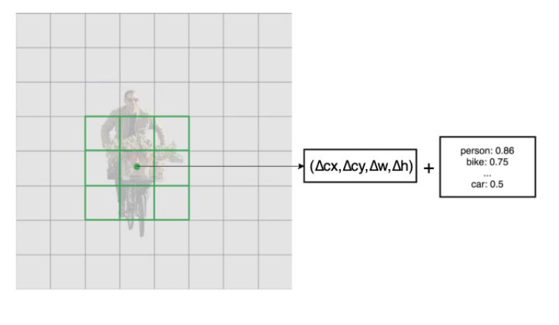
Single Shot MultiBox Detector
output prediction (C + 4)*B
each conv layer output M*N*B*(C+4)

Slide 13
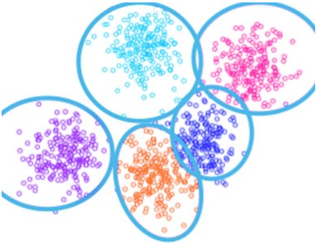
Choosing Bounding Boxes
Previous model try to predict different types of bounding boxes
Empirical results indicate early training can be very unstable.
Bounding boxes do not have arbitrary shapes.

Slide 14
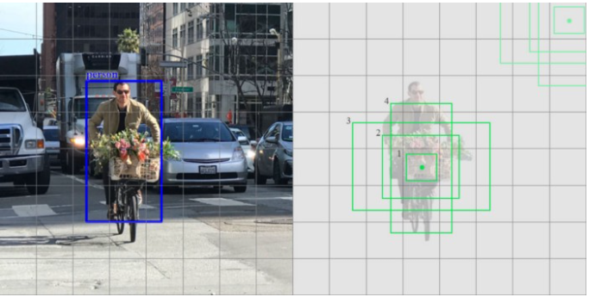
Choosing Bounding Boxes
SSD default boxes are selected manually.
Keeps complexity low and help with training.
SSD also keeps the default boxes to a minimum (4 or 6) with one prediction per default box.

Slide 15
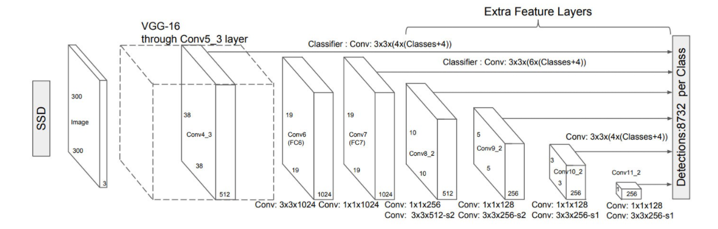
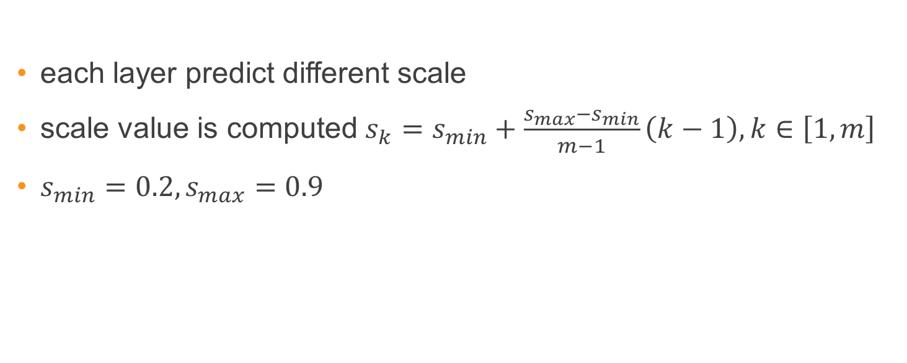
Choosing Bounding Boxes
each layer predict different scale
scale value is computed $s_{k}=s_{min}+\frac{s_{max}−s_{min}}{m−1}\left(k−1\right),k∈\left[1,m\right]$
$s_{min}=0.2,s_{max}=0.9$

Slide 16
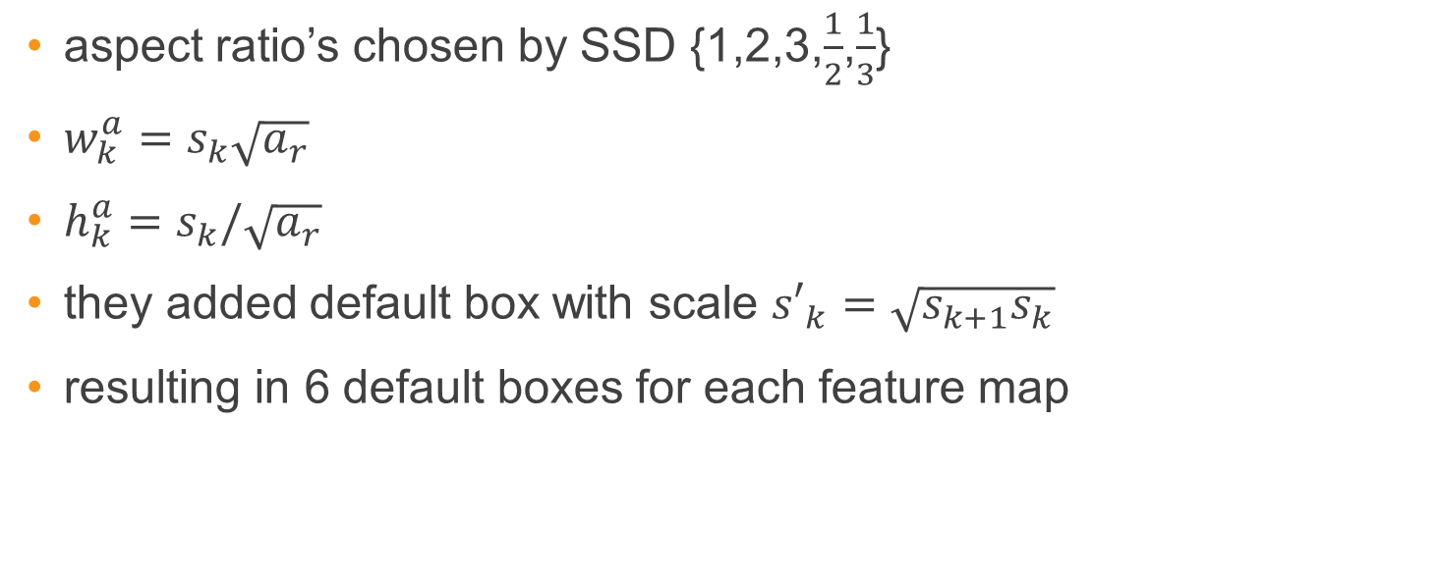
Choosing Bounding Boxes
aspect ratio’s chosen by SSD {1,2,3,$\frac{1}{2}$,$\frac{1}{3}$}
$w_{k}^{a}=s_{k}\sqrt{a_{r}}$
$h_{k}^{a}=s_{k}/\sqrt{a_{r}}$
they added default box with scale ${s′}_{k}=\sqrt{{s_{k+1}s}_{k}}$
resulting in 6 default boxes for each feature map

Slide 17
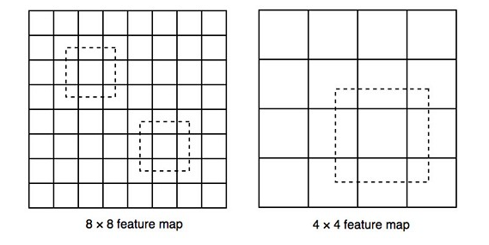
Single Shot MultiBox Detector
bigger feature maps detect smaller objects
Smaller feature maps detect bigger objects

Slide 18
Single Shot MultiBox Detector

Slide 19
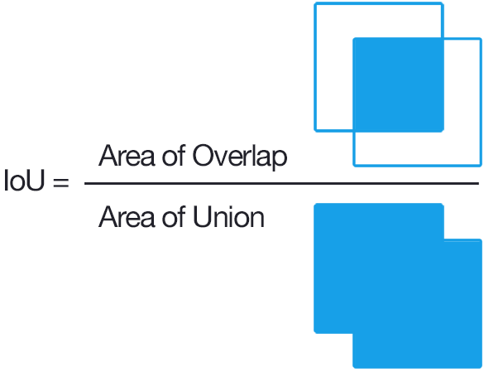
IoU

Slide 20
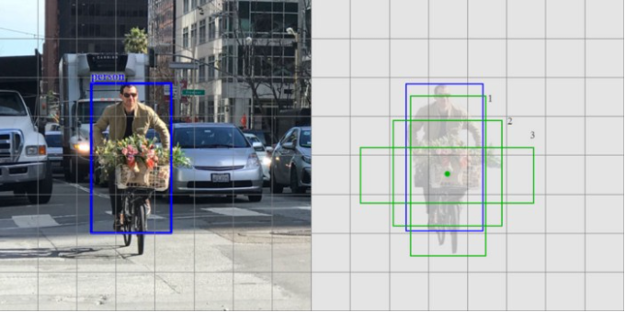
Matching Strategy
SSD predictions are classified as positive matches or negative matches
If the corresponding default boundary box (not the predicted boundary box) has an IoU greater than 0.5 with the ground truth, the match is positive
This processes is repeated for different scales

Slide 21
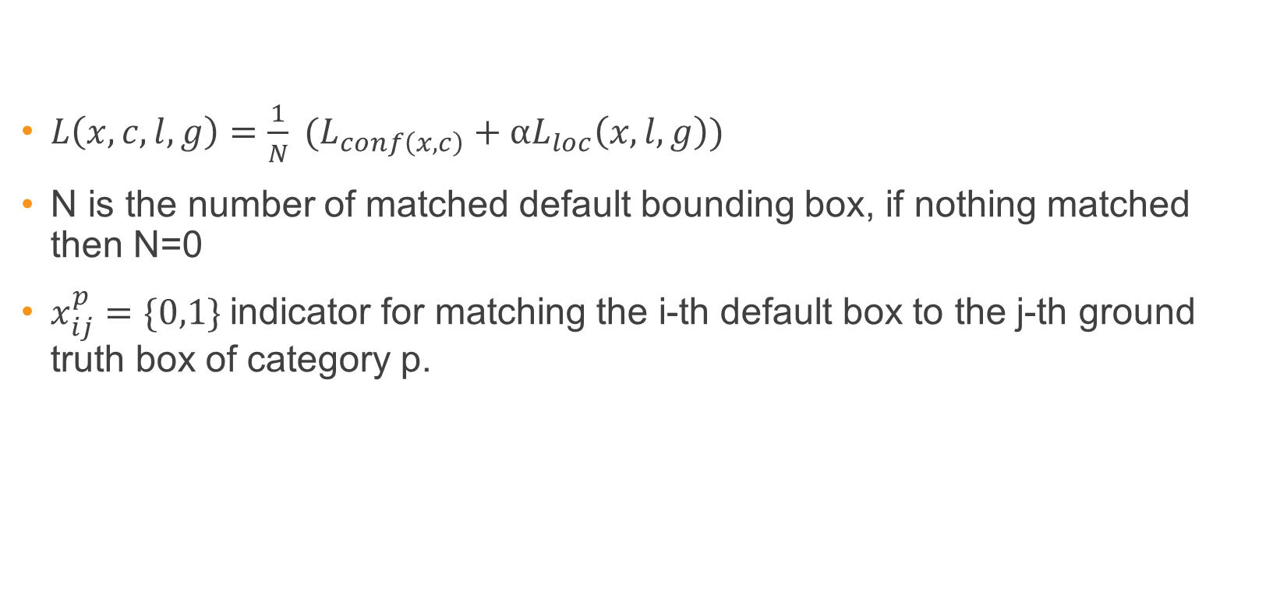
Loss Function
$L\left(x,c,l,g\right)=\frac{1}{N} (L_{conf\left(x,c\right)}+αL_{loc}\left(x,l,g\right))$
N is the number of matched default bounding box, if nothing matched then N=0
$x_{ij}^{p}=\{0,1\}$ indicator for matching the i-th default box to the j-th ground truth box of category p.

Slide 22
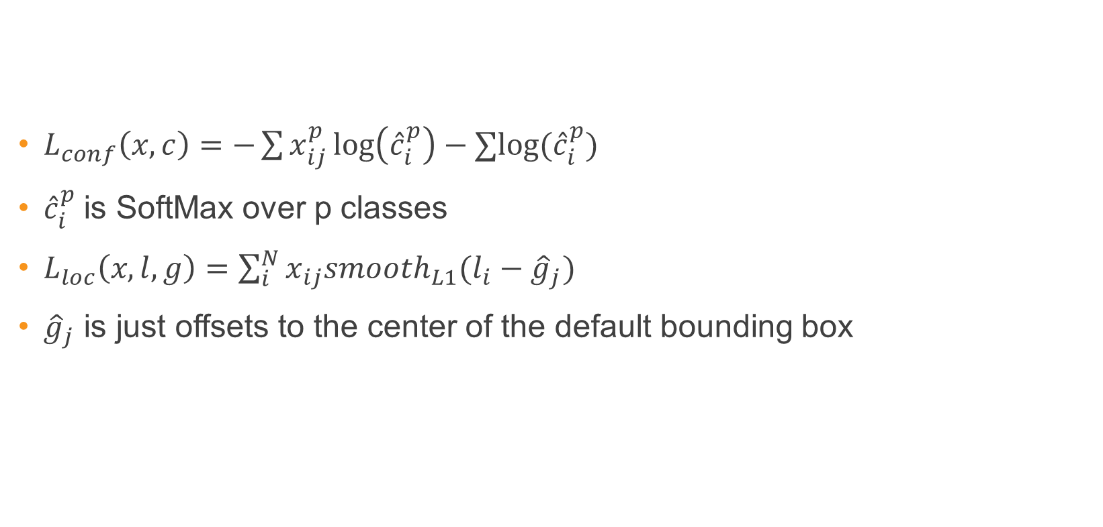
Loss Function
$L_{conf}\left(x,c\right)=−\sum{x_{ij}^{p}\log\left({\hat{c}}_{i}^{p}\right)−∑log⁡({\hat{c}}_{i}^{p})}$
${\hat{c}}_{i}^{p}$ is SoftMax over p classes
$L_{loc}\left(x,l,g\right)=\sum_{i}^{N}{x_{ij}smooth_{L1}(l_{i}−{\hat{g}}_{j})}$
${\hat{g}}_{j}$ is just offsets to the center of the default bounding box

Slide 23
Hard negative mining
we make far more predictions than the number of objects present
there are many more negative matches than positive matches
This creates a class imbalance that hurts training
instead of using all the negatives, we sort those negatives by their calculated confidence loss
SSD picks the negatives with the top loss and makes sure the ratio between the picked negatives and positives is at most 3:1

Slide 24
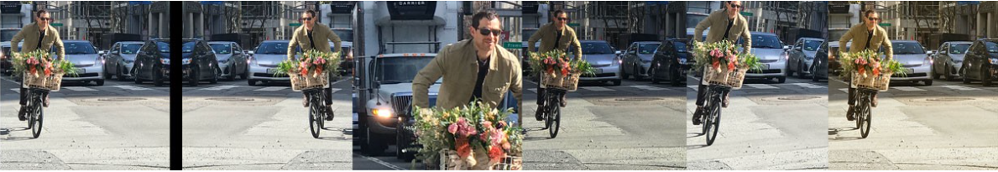
Data Augmention
Use the original
Sample a patch with IoU of 0.1, 0.3, 0.5, 0.7 or 0.9
Randomly sample a patch
color distortion

Slide 25
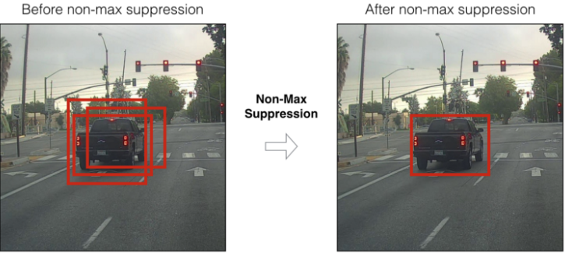
Non-Maximum Suppression
Choose bounding box with highest confidence
Calculate IoU with all the other boxes
Remove the once with IoU bigger than threshold
Repeat until they are no more boxes

Slide 26
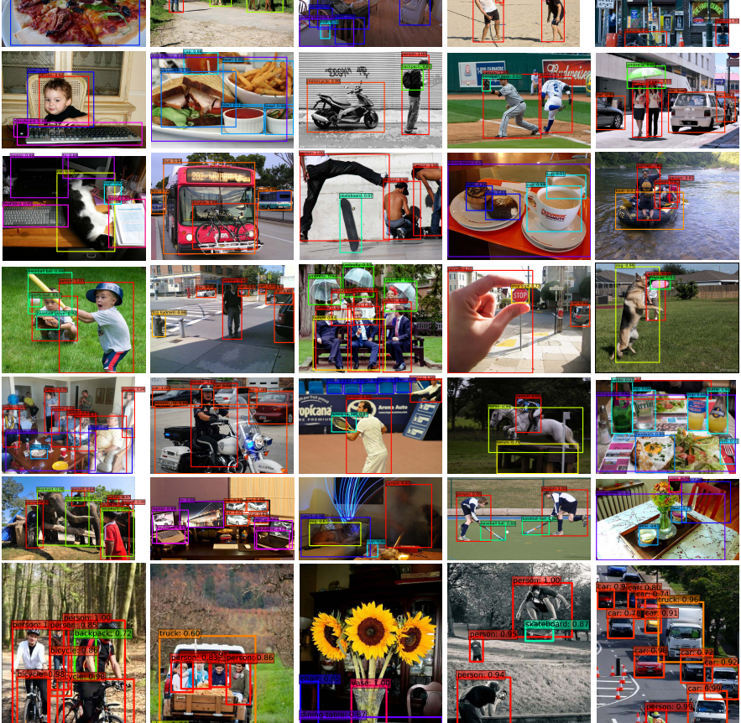
Results

Slide 27
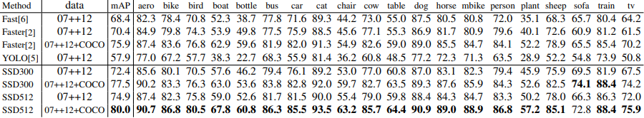
VOC 2012 Dataset

Slide 28
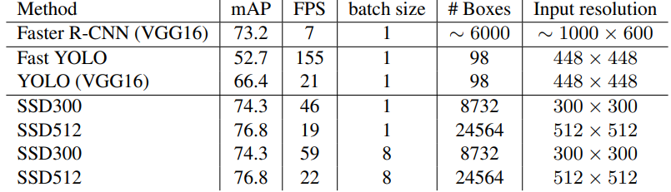
Inference Time

Slide 29
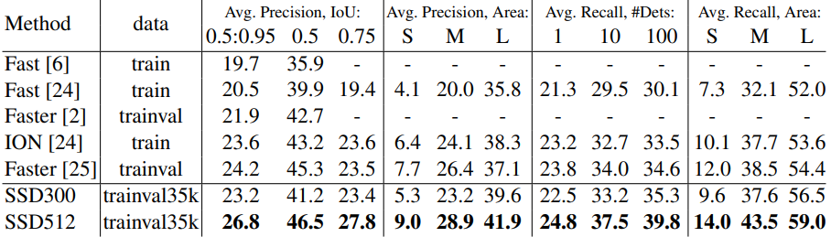
Coco Dataset

Slide 30
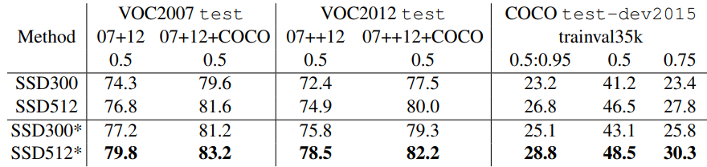
Data Augmentation For Smaller Objects
“zoom out” augmentation
place the image on 16x canvas filled with mean values
add the new image as training example
double up the number of training iteration

Slide 31

Questions

Slide 32
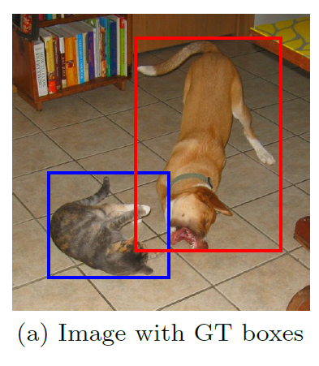
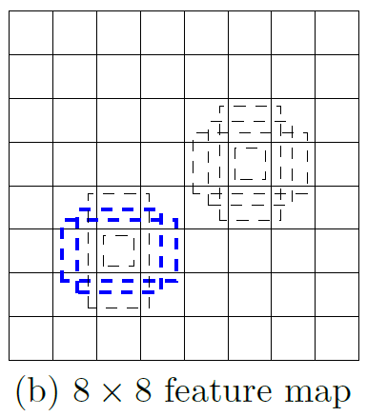
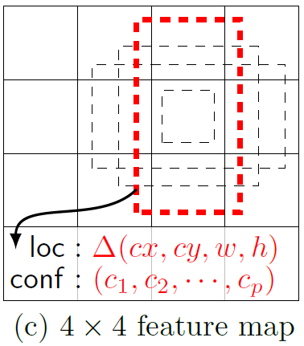
Single Shot MultiBox Detector
74% mAP (mean Average Precision) at 59 frames per second on standard datasets such as PascalVOC and COCO
Single Shot: The tasks of object localization and classification are done in a single forward pass of the network
MultiBox: the name of a technique for bounding box regression, developed by Szegedy et al.
Detector: The network is an object detector that also classifies those detected objects
(from SSD paper)

Slide 33
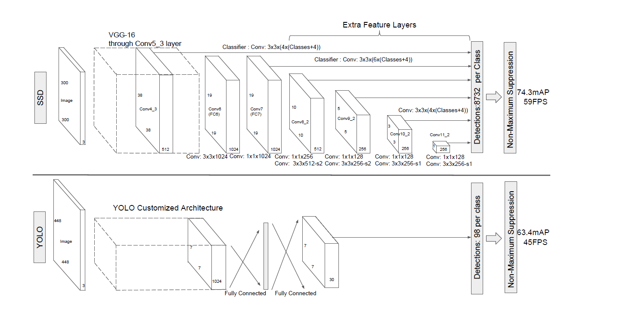
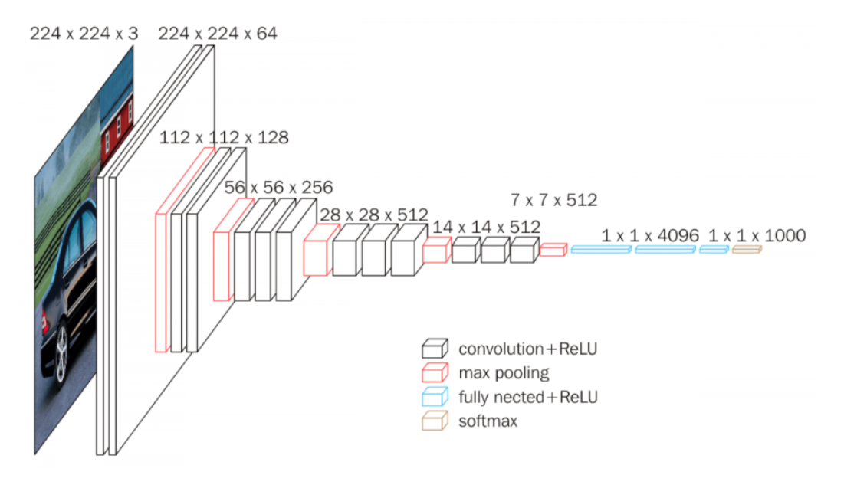
Architecture
SSD and YOLO architecture (from SSD paper)
VGG-16 architecture (from Neurohive)
Notes:
VGG-16 נבחרה בגלל יעילות אבל הופרדה משכבות מחוברות לחלוטין לשכבות עזר בממדים שונים

Slide 34
References
Understanding SSD MultiBox — Real-Time Object Detection In Deep Learning by Eddie Forson, Nov 18, 2017
Click to edit Bullet Point
Click to edit Bullet Point
Click to edit Bullet Point
Click to edit Bullet Point
Click to edit Bullet Point

Slide 35
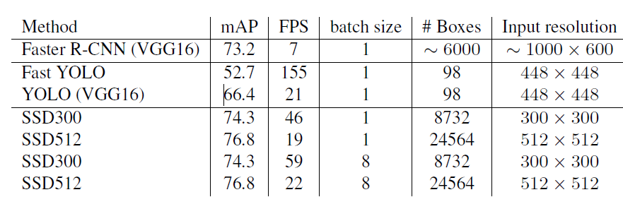
מה עוד
תהליך אימון?
סינון תוצאות עם כמות התאמות גדולה?
מתמטיקה?
תוצאות על המאגרים השונים?
תיאור של ההשוואה בין מולטי בוקס לSSD?
דוגמאות
נקודות תורפה שנשארו במערכת?
Click to edit Bullet Point
Click to edit Bullet Point
Click to edit Bullet Point
Click to edit Bullet Point
Click to edit Bullet Point

Slide 36

Thank you.

Slide 37
Text slide
Click to edit Bullet Point
Click to edit Bullet Point
Click to edit Bullet Point
Click to edit Bullet Point
Click to edit Bullet Point
Click to edit Bullet Point

Slide 38
Text slide
Subtitle
Click to edit Bullet Point
Click to edit Bullet Point
Click to edit Bullet Point
Click to edit Bullet Point
Click to edit Bullet Point
Click to edit Bullet Point

Slide 39

Text + Picture
Click to edit Bullet Point
Click to edit Bullet Point
Click to edit Bullet Point
Click to edit Bullet Point
Click to edit Bullet Point
Click to edit Bullet Point

Slide 40

Text + Picture 2
Click to edit Bullet Point
Click to edit Bullet Point
Click to edit Bullet Point
Click to edit Bullet Point
Click to edit Bullet Point
Click to edit Bullet Point

Slide 41

Text + Picture 3
Click to edit Bullet Point
Click to edit Bullet Point
Click to edit Bullet Point
Click to edit Bullet Point
Click to edit Bullet Point
Click to edit Bullet Point

Slide 42

Text + Picture 4

Slide 43
Graph slide

Slide 44
Graph slide
Click to edit Bullet Point
Click to edit Bullet Point
Click to edit Bullet Point
Click to edit Bullet Point
Click to edit Bullet Point
Click to edit Bullet Point
Graph title

Slide 45
Icon bank

Slide 46
Icon bank

